Slide 1
OpenCL™
Alan S. Ward
Multicore Programming Strategy
EP, SDO
Distinguished Member Technical Staff
OpenCL and the OpenCL logo are trademarks of Apple Inc. used by permission by Khronos.

Slide 2
Where does OpenCL fit?
The following intro to parallel programming has a distinctive workstation feel.
That is on purpose !
Our current large customers are:
Comfortable working with TI platforms
Have large software teams and are willing to invest in low level programming models in exchange for algorithmic control.
Understand DSP programming
However, potential new customers in new markets:
Often are not DSP programmers
Likely do not want to invest in TI proprietary software solutions
At least not up front in the early stages
Often are quite comfortable with the workstation parallel programming models.
Customer Comfort with TI’s multicore parallel programming strategy is a necessity for conversation start !

Slide 3

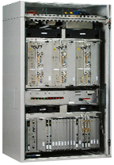


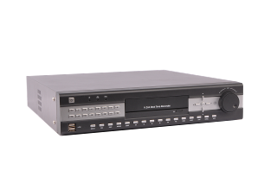
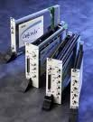
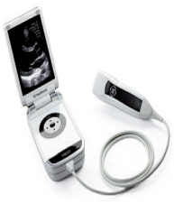



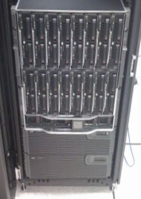
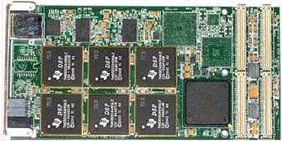




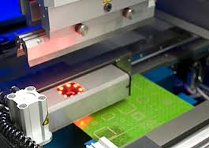

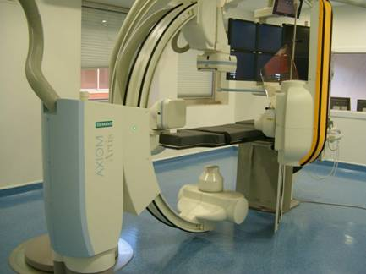

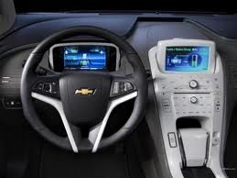
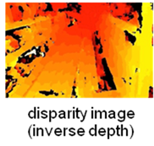


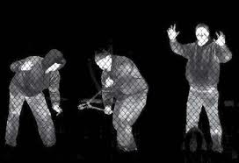
What are the target markets?
DVR / NVR
& smart camera
Networking
Mission critical systems
Medical imaging
Video and audio
infrastructure
High-performance and cloud computing
Portable mobile radio
Industrial imaging
Home AVR and
automotive audio
Analytics
Wireless testers
Industrial control
media processing
computing
radar & communications
industrial electronics

Slide 4
Where does OpenCL fit?
MPI Communication APIs
Node 0
Node 1
Node N
MPI allows expression of parallelism across nodes in a distributed system
MPI’s first spec was circa 1992

Slide 5
Where does OpenCL fit?
MPI Communication APIs
OpenMP Threads
OpenMP Threads
OpenMP Threads
CPU
CPU
CPU
CPU
CPU
CPU
CPU
CPU
CPU
CPU
CPU
CPU
Node 0
Node 1
Node N
OpenMP allows expression of parallelism across homogeneous, shared memory cores
OpenMP’s first spec was circa 1997

Slide 6
Where does OpenCL fit?
MPI Communication APIs
OpenMP Threads
OpenMP Threads
OpenMP Threads
CPU
CPU
CPU
CPU
CPU
CPU
CPU
CPU
CPU
CPU
CPU
CPU
CUDA/OpenCL
CUDA/OpenCL
CUDA/OpenCL
GPU
GPU
GPU
Node 0
Node 1
Node N
CUDA and OpenCL allow expression of parallelism available across heterogeneous computing devices in a system, potentially with distinct memory spaces
The first CUDA was circa 2007 and OpenCL’s first spec was circa 2008

Slide 7
Where does OpenCL fit?
MPI Communication APIs
OpenMP Threads
OpenMP Threads
OpenMP Threads
CPU
CPU
CPU
CPU
CPU
CPU
CPU
CPU
CPU
CPU
CPU
CPU
OpenCL
OpenCL
OpenCL
DSP
DSP
DSP
Node 0
Node 1
Node N
Focus on OpenCL as an open alternative to CUDA
Focus on OpenCL devices other than GPU (for example DSPs)

Slide 8
Where does OpenCL fit?
MPI Communication APIs
CPU
CPU
CPU
CPU
CPU
CPU
CPU
CPU
CPU
CPU
CPU
CPU
OpenCL
OpenCL
OpenCL
Node 0
Node 1
Node N
OpenCL is expressive enough to allow efficient control over all compute engines in a node.

Slide 9
OpenCL What and Why
OpenCL is a framework for expressing programs where parallel computation is dispatched to any attached heterogeneous devices.
OpenCL is open, standard and royalty-free.
OpenCL consists of two relatively easy to learn components:
An API for the host program to create and submit kernels for execution
A host based generic header and a vendor supplied library file
A cross-platform language for expressing kernels
Based on C99 C with a some additions, some restrictions and built-in functions
OpenCL promotes portability of applications from device to device and across generations of a single device roadmap, by
Abstracting low level communication and dispatch mechanisms, and
Using a more descriptive rather than prescriptive data parallel kernel + enqueue mechanism.

Slide 10

OpenCL Platform Model
A host connected to one or more OpenCL devices
Commands are submitted from the host to the OpenCL devices
The host can also be an OpenCL device
An OpenCL device is a collection of one or more compute units (cores)
An OpenCL device is viewed by the OpenCL programmer as a single virtual processor.
i.e. The programmer does not need to know how many cores are in the device. The OpenCL runtime will efficiently divide the total processing effort across the cores.
As an example, on the 66AK2H12
An A15 running an OpenCL application process would be the host.
The 8 C66x DSPs would be available as a single device
With type ACCELERATOR
With 8 compute units (cores)
The 4 A15’s could also be available as a single device
With type CPU
With 4 compute units
66AK2H12
KeyStone II Multicore DSP + ARM
+
*
+
*
-
+
-
+
<<
*
<<
*
C66x DSP
C66x DSP
-
+
-
+
ARM A15
<<
*
<<
*
C66x DSP
C66x DSP
-
+
-
+
ARM A15
<<
*
<<
*
C66x DSP
C66x DSP
ARM A15
-
<<
-
<<
ARM A15
C66x DSP
C66x DSP
Multicore Shared Memory

Slide 11
Host API Languages
C
int err = clGetDeviceIDs(NULL, CL_DEVICE_TYPE_CPU, 1, &device_id, NULL);
if (err != CL_SUCCESS) { … }
context = clCreateContext(0, 1, &device_id, NULL, NULL, &err);
if (!context) { … }
commands = clCreateCommandQueue(context, device_id, 0, &err);
if (!commands) { … }
C++
Context context(CL_DEVICE_TYPE_CPU);
std::vector<Device> devices = context.getInfo<CL_CONTEXT_DEVICES>();
CommandQueue Q(context, devices[0]);
Python
import pyopencl as cl
ctx = cl.create_context_from_type(cl.device_type.CPU)
queue = cl.CommandQueue(ctx)

Slide 12
OpenCL Example Code
OpenCL Host Code
Context context (CL_DEVICE_TYPE_ACCELERATOR);
vector<Device>devices = context.getInfo<CL_CONTEXT_DEVICES>();
Program program(context, devices, source);
Program.build(devices);
Buffer buf (context, CL_MEM_READ_WRITE, sizeof(input));
Kernel kernel (program, "mpy2");
kernel.setArg(0, buf);
CommandQueue Q (context, devices[0]);
Q.enqueueWriteBuffer (buf, CL_TRUE, 0, sizeof(input), input);
Q.enqueueNDRangeKernel(kernel, NDRange(globSz), NDRange(wgSz));
Q.enqueueReadBuffer (buf, CL_TRUE, 0, sizeof(input), input);
OpenCL Kernel
Kernel void mpy2(global int *p)
{
int i = get_global_id(0);
p[i] *= 2;
}
The host code is using the optional OpenCL C++ bindings
It creates a buffer and a kernel, sets the arguments, writes the buffer, invokes the kernel and reads the buffer.
The Kernel is purely algorithmic
No dealing with DMA’s, cache flushing, communication protocols, etc.

Slide 13
How to build an OpenCL application
For any file the includes the OpenCL headers, you need to tell gcc where the headers are for the compiler step:
gcc –I$TI_OCL_INSTALL/include …
When linking an OpenCL application you need to link with the TI OpenCL library.
gcc <obj files> -L$TI_OCL_INSTALL/lib –lTIOpenCL …

Slide 14
Platform Layer
A few of the OpenCL host API’s are considered to be the platform layer.
These APIs allow an OpenCL application to:
Query the platform for OpenCL devices
Query OpenCL devices for their configuration and capabilities
Create OpenCL contexts using one or more devices.
Context context (CL_DEVICE_TYPE_ACCELERATOR);
vector<Device>devices = context.getInfo<CL_CONTEXT_DEVICES>();
These lines
Query the platform for all available accelerator devices
Creates an OpenCL context containing all those devices
Queries the context to enumerate the devices and place them in a vector.
Kernels dispatched within this context will run on accelerators (DSPs).
To change the program to run kernels on a CPU device instead: change CL_DEVICE_TYPE_ACCELERATOR to CL_DEVICE_TYPE_CPU.

Slide 15
OpenCL Execution Model
OpenCL C Kernel
Basic unit of executable code on a device - similar to a C function
Can be Data-parallel or task-parallel
OpenCL C Program
Collection of kernels and other functions
OpenCL Applications queue kernel execution instances
The application defines command queues
A command queue is tied to a specific device
Any/All devices may have command queues
The application enqueues kernels to these queues.
The kernels will then run asynchronously to the main application thread.
The queues can be defined to execute in-order or allow out-of-order.

Slide 16
Data Parallel Kernel Execution
A data parallel kernel enqueue is a combination of
An OpenCL C kernel definition (expressing an algorithm for a work-item)
A description of the total number of work-items required for the kernel
Can be 1, 2, or 3 dimensional
Kernel void mpy2(global int *p)
{
int i = get_global_id(0);
p[i] *= 2;
}
CommandQueue Q (context, devices[0]);
Kernel kernel (program, "mpy2");
Q.enqueueNDRangeKernel(kernel, NDRange(1024));
The work-items for a kernel execution are grouped into workgroups
The size of a workgroup can be specified, or left to the runtime to define
A workgroup is executed by a compute unit (core)
Different workgroups can execute asynchronously across multiple cores
Q.enqueueNDRangeKernel(kernel, NDRange(1024), NDRange(128));
This would enqueue a kernel with 1024 work-items grouped in workgroups of 128 work-items each. There would therefore be 1024/128 => 8 workgroups, that could execute simultaneously on 8 cores.

Slide 17
Execution Order: work-items and workgroups
The execution order of work-items in a workgroup is not defined by the spec. Portable OpenCL code must assume they could all execute concurrently.
GPU implementations do typically execute work-items within a workgroup concurrently.
CPU and DSP implementation typically serialize work-items within a workgroup.
OpenCL C barrier instructions can be used to ensure that all work-items in a workgroup reach the barrier, before any work-items in the WG proceed past the barrier.
The execution order of workgroups associated with 1 kernel execution is not defined by the spec. Portable OpenCL code must assume any order is valid.
No mechanism exits in OpenCL to synchronize or order workgroups

Slide 18
Vector Sum Reduction Example
int acc = 0;
for (int i = 0; i < N; ++i) acc += buffer[i];
return acc;
Sequential in nature
Not parallel

Slide 19
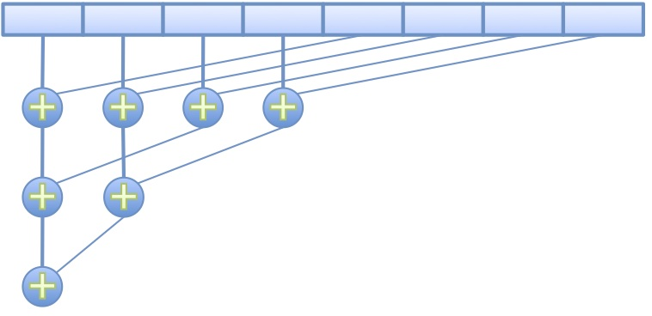
Parallel Vector Sum Reduction
kernel void sum_reduce(global float* buffer, global float* result)
{
int gid = get_global_id(0); // which work-item am I out of all work-items
int lid = get_local_id (0); // which work-item am I within my workgroup
for (int offset = get_local_size(0) >> 1; offset > 0; offset >>= 1)
{
if (lid < offset) buffer[gid] += buffer[gid + offset];
barrier(CLK_GLOBAL_MEM_FENCE);
}
if (lid == 0) result[get_group_id(0)] = buffer[gid];
}

Slide 20
Parallel Vector Sum Reduction (Iterative DSP)
kernel void sum_reduce(global float* buffer, local float *acc, global float* result)
{
int gid = get_global_id(0); // which work-item am I out of all work-items
int lid = get_local_id (0); // which work-item am I within my workgroup
bool first_wi = (lid == 0);
bool last_wi = (lid == get_local_size(0) – 1);
int wg_index = get_group_id (0); // which workgroup am I
if (first_wi) acc[wg_index] = 0;
acc[wg_index] += buffer[gid];
if (last_wi) result[wg_index] = acc[wg_index];
}
Not valid on a GPU
Could be valid on a device that serializes work-items in a workgroup, i.e. DSP

Slide 21
OpenCL Example - Revisited
OpenCL Host Code
Context context (CL_DEVICE_TYPE_ACCELERATOR);
vector<Device>devices = context.getInfo<CL_CONTEXT_DEVICES>();
Program program(context, devices, source);
Program.build(devices);
Buffer buf (context, CL_MEM_READ_WRITE, sizeof(input));
Kernel kernel (program, "mpy2");
kernel.setArg(0, buf);
CommandQueue Q (context, devices[0]);
Q.enqueueWriteBuffer (buf, CL_TRUE, 0, sizeof(input), input);
Q.enqueueNDRangeKernel(kernel, NDRange(globSz), NDRange(wgSz));
Q.enqueueReadBuffer (buf, CL_TRUE, 0, sizeof(input), input);
OpenCL Kernel
kernel void mpy2(global int *p)
{
int i = get_global_id(0);
p[i] *= 2;
}
Recognize the Kernel and enqueueNDRangeKernel.

Slide 22
OpenCL Memory Model
Private Memory
Per work-item
Typically registers
Local Memory
Shared within a workgroup
Local to a compute unit (core)
Global/Constant Memory
Shared across all compute units (cores) in a device
Host Memory
Attached to the Host CPU
Can be distinct from global memory
Read / Write buffer model
Can be same as global memory
Map / Unmap buffer model
Memory management is explicit You must move data from host -> global -> local and back
Workgroup
Workgroup
Private Memory
Private Memory
Private Memory
Private Memory
Work-Item
Work-Item
Work-Item
Work-Item
Local Memory
Local Memory
Global/Constant Memory
Computer Device
Host Memory
Host

Slide 23
Parallel Vector Sum Reduction (local memory)
kernel void sum_reduce(global float* buffer, local float* scratch, global float* result)
{
int lid = get_local_id (0); // which work-item am I within my workgroup
scratch[lid] = buffer[get_global_id(0)];
barrier(CLK_LOCAL_MEM_FENCE);
for (int offset = get_local_size(0) >> 1; offset > 0; offset >>= 1)
{
if (lid < offset) scratch[lid] += scratch[lid + offset];
barrier(CLK_LOCAL_MEM_FENCE);
}
if (lid == 0) result[get_group_id(0)] = scratch[lid];
}

Slide 24
Memory Resources
Buffers
Simple chunks of memory
Kernels can access however they like (array, pointers, structs)
Kernels can read and write buffers
Images
Opaque 2D or 3D formatted data structures
Kernels access only via read_image() and write_image()
Each image can be read or written in a kernel, but not both
Only required for GPU devices !

Slide 25
Distinct Host and Global Device Memory
char *ary = malloc(globsz);
for (int i = 0; i < globsz; i++) ary[i] = i;
Buffer buf (context, CL_MEM_READ_WRITE, sizeof(ary));
Q.enqueueWriteBuffer (buf, CL_TRUE, 0, sizeof(ary), ary);
Q.enqueueNDRangeKernel(kernel, NDRange(globSz), NDRange(wgSz));
Q.enqueueReadBuffer (buf, CL_TRUE, 0, sizeof(ary), ary);
for (int i = 0; i < globsz; i++) … = ary[i];
Host Memory
Device Global Memory
0,1,2,3, …
0,1,2,3 …
0,2,4,6, …
0,2,4,6 …

Slide 26
Shared Host and Global Device Memory
Buffer buf (context, CL_MEM_READ_WRITE, globsz);
char* ary = Q.enqueueMapBuffer(buf, CL_TRUE, CL_MAP_WRITE, 0, globsz);
for (int i = 0; i < globsz; i++) ary[i] = i;
Q.enqueueUnmapMemObject(buf, ary);
Q.enqueueNDRangeKernel(kernel, NDRange(globSz), NDRange(wgSz));
ary = Q.enqueueMapBuffer(buf, CL_TRUE, CL_MAP_READ, 0, globsz);
for (int i = 0; i < globsz; i++) … = ary[i];
Q.enqueueUnmapMemObject(buf, ary);
Shared Host + Device Global Memory
0,1,2,3, …
0,2,4,6, …
Ownership to device
Ownership to host
Ownership to host
Ownership to device

Slide 27
OpenCL Example - Revisited
OpenCL Host Code
Context context (CL_DEVICE_TYPE_ACCELERATOR);
vector<Device>devices = context.getInfo<CL_CONTEXT_DEVICES>();
Program program(context, devices, source);
Program.build(devices);
Buffer buf (context, CL_MEM_READ_WRITE, sizeof(input));
Kernel kernel (program, "mpy2");
kernel.setArg(0, buf);
CommandQueue Q (context, devices[0]);
Q.enqueueWriteBuffer (buf, CL_TRUE, 0, sizeof(input), input);
Q.enqueueNDRangeKernel(kernel, NDRange(globSz), NDRange(wgSz));
Q.enqueueReadBuffer (buf, CL_TRUE, 0, sizeof(input), input);
OpenCL Kernel
kernel void mpy2(global int *p)
{
int i = get_global_id(0);
p[i] *= 2;
}
Recognize the Buffer creation and data movement enqueues

Slide 28
OpenCL Synchronization
A kernel execution is defined to be the execution and completion of all work-items associated with an enqueue kernel command.
Kernel executions can synchronize at their boundaries through OpenCL events at the Host API level. Example follows.
Within a workgroup, work-items can synchronize through barriers and fences. The barriers and fences are expressed as OpenCL C built-in functions. See previous example.
Workgroups cannot synchronize with workgroups
Work-items in different workgroups cannot synchronize

Slide 29
OpenCL Dependencies using Events
std::vector<Event> k2_deps(1, Event());
std::vector<Event> rd_deps(1, Event());
Q1.enqueueTask (k1, NULL, &k2_deps[0]);
Q2.enqueueTask (k2, &k2_deps, &rd_deps[0]);
Q2.enqueueReadBuffer (buf, CL_TRUE, 0, size, ary, &rd_deps, NULL);
Q1
K1
Device 1
Q2
K2
Rd
Device 2
Device 1 Execution
K1
Device 2 Execution
K2
Rd

Slide 30
Using Events on the Host
clWaitForEvents(num_events, *event_list)
Blocks until events are complete
clEnqueueMarker(queue, *event)
Returns an event for a marker that moves through the queue
clEnqueueWaitForEvents(queue, num_events, *event_list)
Inserts a “WaitForEvents” into the queue
clGetEventInfo()
Command type and status CL_QUEUED, CL_SUBMITTED, CL_RUNNING, CL_COMPLETE, or error code
clGetEventProfilingInfo()
Command queue, submit, start, and end times

Slide 31
OpenCL Example – Building Kernels
OpenCL Host Code
Context context (CL_DEVICE_TYPE_ACCELERATOR);
vector<Device>devices = context.getInfo<CL_CONTEXT_DEVICES>();
Program program(context, devices, source);
Program.build(devices);
Buffer buf (context, CL_MEM_READ_WRITE, sizeof(input));
Kernel kernel (program, "mpy2");
kernel.setArg(0, buf);
CommandQueue Q (context, devices[0]);
Q.enqueueWriteBuffer (buf, CL_TRUE, 0, sizeof(input), input);
Q.enqueueNDRangeKernel(kernel, NDRange(globSz), NDRange(wgSz));
Q.enqueueReadBuffer (buf, CL_TRUE, 0, sizeof(input), input);
OpenCL Kernel
kernel void mpy2(global int *p)
{
int i = get_global_id(0);
p[i] *= 2;
}
There are 4 ways to kernels and their compilation
Online vs. Offline
File based vs. embedded object
Examples follow

Slide 32
Building Kernels – Online Compilation
Online compilation with inline OpenCL C source.
Online compilation with OpenCL C source.
TI Implementation note: After online compilation, the resultant binaries are cached and will not be rebuilt unless you change the source or the compilation options (or reboot).
const char * kSrc= "kernel void devset(global char* buf) "
"{ buf[get_global_id(0)] = 'x'; }";
Program::Sources source(1, std::kSrc, kSrc)));
Program program = Program(context, source);
program.build(devices);
ifstream t(“kernels.cl");
if (!t) { … }
std::string kSrc((istreambuf_iterator<char>(t)),
istreambuf_iterator<char>());
Program::Sources source(1, make_pair(kSrc.c_str(), kSrc.length()));
Program program = Program(context, source);
program.build(devices);
kernels.cl
kernel void devset(global char* buf)
{ buf[get_global_id(0)] = 'x'; }

Slide 33
Building Kernels – Offline Compilation
Offline compilation with OpenCL C binary file.
Offline compilation Inline OpenCL C binary string.
char *bin
int bin_length = read_binary(“kernels.out”, bin);
Program::Binaries binaries(numDevices);
for (int d = 0; d < numDevices; d++)
binaries[d] = std::make_pair(bin, bin_length);
Program program(context, devices, binaries);
Program.build(devices);
kernels.cl
kernel void devset(global char* buf)
{ buf[get_global_id(0)] = 'x'; }
ocl66 –o3 –bin kernels.cl
kernels.out
kernels.cl
kernel void devset(global char* buf)
{ buf[get_global_id(0)] = 'x'; }
#include “kernels.h”
int bin_length = strlen(cl_acc_bin);
Program::Binaries binaries(numDevices);
for (int d = 0; d < numDevices; d++)
binaries[d] = std::make_pair(cl_acc_bin, bin_length);
Program program(context, devices, binaries);
Program.build(devices);
ocl66 –o3 –var kernels.cl
kernels.h
char cl_acc_bin[] = { 127, 69, 76, ..... } ;

Slide 34
OpenCL Operational Flow

Slide 35
OpenCL C Language
Derived from ISO C99
No standard C99 headers, function pointers, recursion, variable length arrays, and bit fields
Additions to the language for parallelism
Work-items and workgroups
Vector types
Synchronization
Address space qualifiers
Optimized image access
Built-in functions. Many!

Slide 36
Native Vector Types
Portable
Vector length of 2, 3, 4, 8, and 16
Ex. char2, ushort4, int8, float16, double2, …
Endian safe
Aligned at vector length
Vector literals
int4 vi0 = (int4) -7;
int4 vi1 = (int4)(0, 1, 2, 3);
Vector components
vi0.lo = vi1.hi;
int8 v8 = (int8)(vi0, vi1.s01, vi1.odd);
Vector ops
vi0 += vi1;
vi0 = sin(vi0);

Slide 37
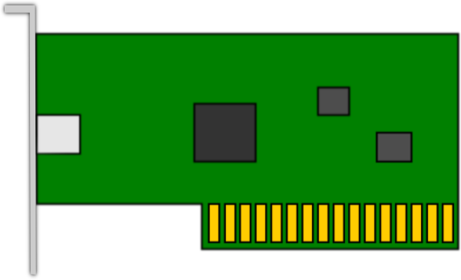
TI OpenCL 1.1 Products*
66AK2H12
KeyStone II Multicore DSP + ARM
TMS320C6678
8 C66 DSPs
1GB DDR3
1GB DDR3
TMS320C6678
8 C66 DSPs
+
*
+
*
-
+
-
+
<<
*
<<
*
C66x DSP
C66x DSP
TMS320C6678
8 C66 DSPs
1GB DDR3
1GB DDR3
TMS320C6678
8 C66 DSPs
-
+
-
+
ARM A15
<<
*
<<
*
C66x DSP
C66x DSP
-
+
-
+
ARM A15
<<
*
<<
*
C66x DSP
C66x DSP
ARM A15
-
<<
-
<<
ARM A15
C66x DSP
C66x DSP
Multicore Shared Memory
Advantech DSPC8681 with four 8-core DSPs
Advantech DSPC8682 with eight 8-core DSPs
Each 8 core DSP is an OpenCL device
Ubuntu Linux PC as OpenCL host
OpenCL in limited distribution Alpha
GA approx. EOY 2013
OpenCL on a chip
4 ARM A15s running Linux as OpenCL host
8 core DSP as an OpenCL Device
6M on chip shared memory.
Up to 10G attached DDR3
GA approx. EOY 2013
* Product is based on a published Khronos Specification, and is expected to pass the Khronos Conformance Testing Process.
Current conformance status can be found at www.khronos.org/conformance.

Slide 38
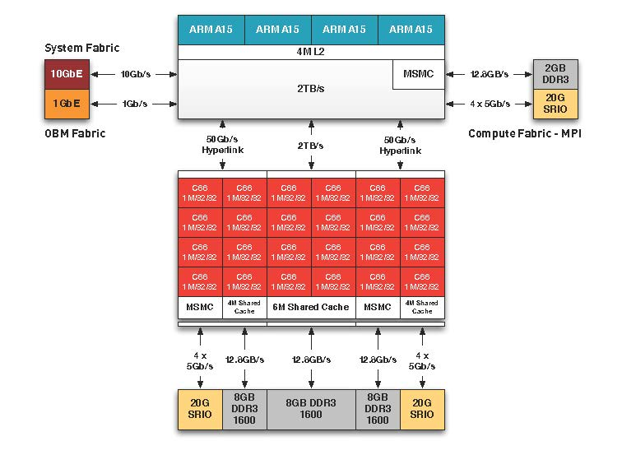


TI OpenCL Coming Soon!
1 66AK2H12 + 2 TMS3206678
4 ARM A15 @ 1.4Ghz
24 C66 DSPs @ 1.2Ghz
115 Gflops DP
460 Gflops SP
26 GB DDR3

Slide 39
OpenCL 1.2
TI will support OpenCL 1.1 in our first GA releases.
There are a couple of OpenCL 1.2 features that are useful.
These are not currently planned, but based on demand, may be released as extensions to our 1.1 support before a compatible 1.2 product is available.
The 1.2 features of interest are:
Custom Devices, and
Device Partitioning

Slide 40
OpenCL 1.2 Custom Device
A compliant OpenCL device is required to support both
the OpenCL runtime, and
the OpenCL C kernel language.
A Custom Device in OpenCL 1.2 is required to support:
the OpenCL runtime, but
NOT the OpenCL C kernel language.
Two obvious uses would be:
A device which is programmed by an alternative language (ASM, DSL, etc.)
A device which requires no programming, but has fixed functionality
Programs for custom devices can be created using:
the standard OpenCL runtime APIs that allow programs created from source, or
the standard OpenCL runtime APIs that allow programs created from binary, or
from built-in kernels supported by the device , and exposed by name

Slide 41
OpenCL Custom Device Example
OpenCL Host Code
Context context (CL_DEVICE_TYPE_CUSTOM);
vector<Device>devices = context.getInfo<CL_CONTEXT_DEVICES>();
Program program(context, devices, source);
Program.build(devices);
Buffer buf (context, CL_MEM_READ_WRITE, sizeof(input));
Kernel kernel (program, "mpy2");
kernel.setArg(0, buf);
CommandQueue Q (context, devices[0]);
Q.enqueueWriteBuffer (buf, CL_TRUE, 0, sizeof(input), input);
Q.enqueueNDRangeKernel(kernel, NDRange(globSz), NDRange(wgSz));
Q.enqueueReadBuffer (buf, CL_TRUE, 0, sizeof(input), input);
OpenCL Kernel
mpy2:
CALLP get_global_id
|| MV A4,A10
LDW *+A10[A4],A3
ADD A3,A3,A3
STW A3,*+A10[A4]
RET
Note
Consistent API calls
A different kernel language and device discovery flag for context creation
Typically would create context with both custom devices and standard devices

Slide 42
Custom Device w/ Built-in Kernel
OpenCL Host Code
Context context (CL_DEVICE_TYPE_CUSTOM);
vector<Device>devices = context.getInfo<CL_CONTEXT_DEVICES>();
Program program(context, devices, “builtin-mpy2”);
Program.build(devices);
Buffer buf (context, CL_MEM_READ_WRITE, sizeof(input));
Kernel kernel (program, "mpy2");
kernel.setArg(0, buf);
CommandQueue Q (context, devices[0]);
Q.enqueueWriteBuffer (buf, CL_TRUE, 0, sizeof(input), input);
Q.enqueueNDRangeKernel(kernel, NDRange(globSz), NDRange(wgSz));
Q.enqueueReadBuffer (buf, CL_TRUE, 0, sizeof(input), input);
In this custom device example, there is no source required
The application simply dispatches a named built-in function
There are device query API’s to extract the built-in function names available for a device

Slide 43
OpenCL Custom Device Why?
You might ask: why expose custom language devices or fixed function devices in OpenCL? Arguments include:
I can already do that outside an OpenCL context, or
The resultant OpenCL program may not be portable to other platforms.
You would be correct, but by exposing these devices in OpenCL, you will get:
The ability to share buffers between custom devices and other devices,
The ability to coordinate kernels using OpenCL events to establish dependencies, and
A consistent API for handling data movement and task dispatch.

Slide 44
OpenCL 1.2 Device Partitioning
Provides a mechanism for dividing a device into sub-devices
Can be used:
To allow finer control of work assignment to compute units
Reserve a portion of a device for higher priority tasks
Group compute units based on shared resources (such as a cache)
Can partition:
Equally (4 sub devices)
Explicitly (3,5 C.U.s)
Based on affinity
Sub Devices
Host
Host
Device
SubDevice
SubDevice
DSP
DSP
DSP
DSP
Becomes
DSP
DSP
DSP
DSP
DSP
DSP
DSP
DSP
DSP
DSP
DSP
DSP

